Slide 1


General psychology
Chapter one : Unit One:
Definition and concepts of Psychology

Slide 2
Brainstorming
What comes to your mind when you hear the word psychology?
Have you read or listened to anything related to psychology?
What was its content about?
Did you appreciate it? Why?
What do you expect from the course in psychology

Slide 3
Definition and concepts of Psychology
Psychology: is composed of two Greek words
Psyche: Soul, mind, consciousness
Logos: Study, knowledge or science
Thus, for those ancient Greek philosophers, psychology was defined as the study of mind or soul.
Scientifically, psychology is defined as the scientific study of behavior and mental processes of both humans beings and other animals.

Slide 4
Cont……
Psychology studies behavior:
To make inferences about what the persons does & process in his /her mind:
1.Overt behaviors (observed and measured directly).
2.Covert behaviors (mind or mental process such as feelings, attitudes, thought etc.) are studied.
Un like other behavioral sciences, Psychology exclusively studies individual behavior and covers wide range of behaviors.

Slide 5
Cont…
Behavior in its broader sense includes all types of human activities.
Example-
Motor activities (Walking, speaking)
Cognitive activities (perceiving, remembering, thinking, reasoning)
Emotional activities (feeling happy, sad, angry, afraid)
Behavior is both mental and bodily.

Slide 6
Is psychology is science or an art?
Psychology is a science:
Psychologists like any other scientists do experiments & follow scientific procedures to understand & solve human problems.
Psychology is an art:
psychology focuses on the application of science to prevent and control human problems.
i.e. Making life from worse to easy

Slide 7
1.2. Goals of Psychology
1.Describing: is giving clear picture about the phenomena or telling about what some thing is like.
2.Explaining: is all about suggesting possible reasons why it/the behavior happened.
3.Predicting: Once we know what happens, and why it happens, we can begin to speculate or predict what will happen in the future.
4.Controlling: this is the last but the most goal of psychology & refers to helping, limiting, influencing, and changing the behavior.

Slide 8
1.3. Historical roots of Psychology
Psychology as a science was established by Wilhelm Wundt in 1879.
He was the first man to establish the first psychological laboratory.
Psychology begins as a science of mental life.
Wundt saw psychology as the study of conscious experience or understanding mental process focusing on inner sensation, feeling and thought.

Slide 9
Cont…….. Historical
He did this through introspection, asking the person to describe what was going on in his/her mind.
Until 1920 psychology remained as the science of mental life. From 1920 to 1960 psychology refined as the science of observable and measurable behavior by American Psychologist Watson.
After 1960’s Psychology considered studying both mental process and outer behavior.

Slide 10
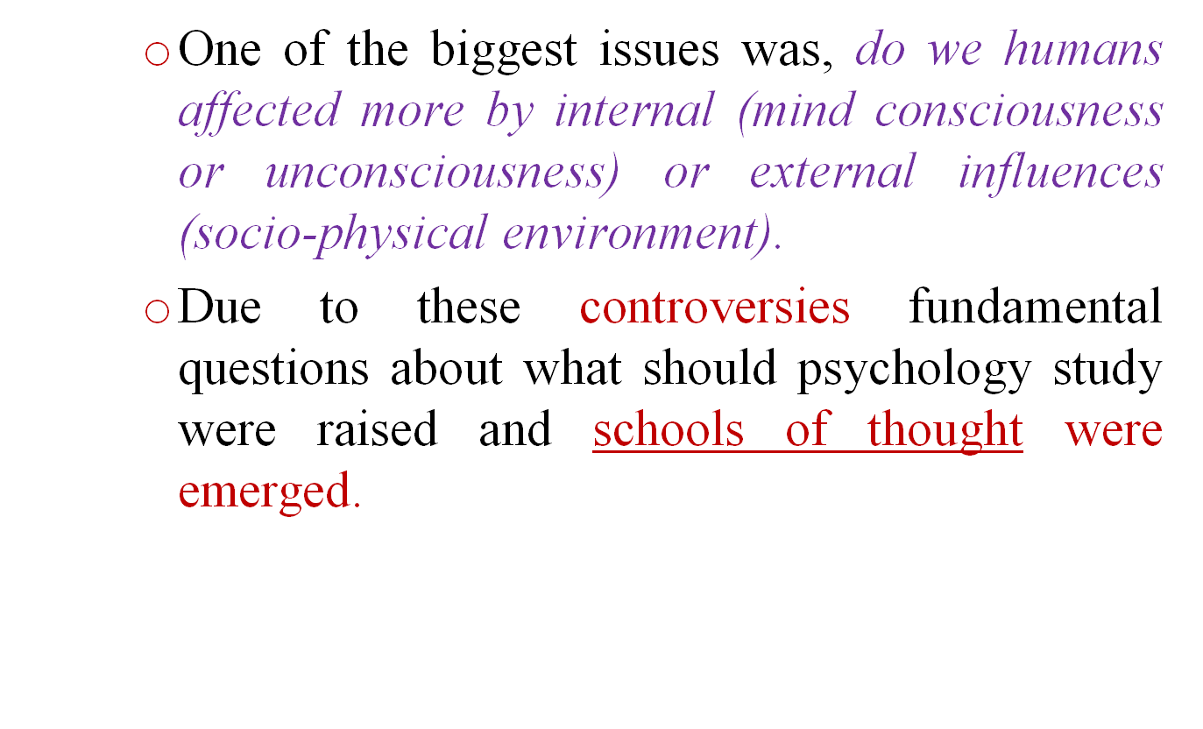
Cont…… Historical

Slide 11
I. Early schools of Psychology
1. Structuralism
Psychology studies about the structure/element of the mind.
founded by Wilhelm Wundt (founder of modern psychology).
He saw psychology as the study of conscious experience.
He did this through introspection (asking the person to describe what is doing in the mind).
Analyzing the mental experience into three basic mental elements: images, feelings, and sensations

Slide 12
Cont…. Early schools
2.Functionalism
William James pioneered functionalism
Psychology studies about the function of the mind
How the mind allows people to function in the real world; how people work, play, and adapt to their surroundings,
More interested in how the mind functions and emphasis on adaptive function of mind and behavior to the changing environment.
Examining human mind in terms of its structural elements and functions.

Slide 13
Cont……. Early schools
3 Gestalt psychology Max Wertheimer, who studied sensation and perception.
Gestalt – “good figure” psychology.
Psychology should study about the whole mind
Gestalt ideas are now part of the study of cognitive psychology, a field focusing not only on perception but also on learning, memory, thought processes, and problem solving
Instead of considering separate parts that make up thinking, Gestalt psychologists concentrated on the ‘whole’.

Slide 14
Cont… Early schools
Human beings and other animals perceive the external world as an organized pattern, not as individual sensations.
The motto of Gestalt psychologists is “The whole is greater than the sum of its parts”.
I.e. Behavior should be studied as a whole than a separate incidences.
Mind should be thought of as a result of the whole pattern of sensory activity and the relationships and organizations within their pattern.

Slide 15
Cont…. Early schools
4. Behaviorism
Founded by Watson.
Believed that Psychology should study not subjective behavior rather observable and measurable behaviors.
The behaviorists also stressed the importance of the environment in shaping an individual’s behavior.

Slide 16
Cont…. Early schools
5. Psychoanalysis-
Sigmund Freud founded this school of thought.
Psychology studies about the components of the unconscious part of the human mind.
Believed that behavior is determined by powerful inner forces.
Assumed that peoples repress some of their behaviors which in turn causes personal disturbance.
some of the physical illnesses of his patients didn‘t have medical or bodily causes; but non-physical or emotional causes

Slide 17
Cont….. Early schools
The unconscious which is the subject matter of psychoanalysis contains hidden wishes, passions, guilty secrets, unspeakable yearnings, and conflict between desire and duty.
We are not aware of our unconscious urges and thoughts and they make themselves known in dreams, slip of the tongue, apparent accidents and even jokes.
He used clinical case studies (hypnosis and Dream analysis) as a method.

Slide 18
II. Modern Perspectives of Psychology
The Biological Perspective
relate behavior to functions of the body such as activities of their nervous and glandular systems.
2. The Cognitive Perspective
we perceive the world around us and process information differently.
differences in the ways we receive and process information may lead to differences in behavior.

Slide 19
Cont…. Modern Perspectives
3.The social perspective
the interactions between and among people influence mind and behavior.
It is the social setting that determines an individual’s behavior.
4. Developmental perspective
behavior is changed as people grow older/ (mature) i.e. behavior change due to age

Slide 20
Cont…. Modern Perspectives
5.Humanistic perspective
human beings have free will (i.e. they are not under the control of both internal & external factors).
we can choose how to behave , rather than shaped by d/t factors.
6. The Psychoanalytic perspective
focuses on the role of feelings and impulses which are unconscious.
7. Behaviorism
all behavior is learned. (i.e rewarded behavior will more likely to appear & un rewarded will terminate.

Slide 21
Cont…. Modern Perspectives
8. Socio-cultural Perspective- It focuses on the social and cultural factors that affects human behavior.
As a fish cannot leave without water, human behavior cannot be understood without sociocultural context (the social and cultural environment) that people "Swim" in every day.
For instance, social psychologists examine how group membership affects attitudes and behaviors, why authority and other people (like spouse, lovers, friends, bosses, parents, and strangers) affect each of us.

Slide 22
1.4. Sub Fields (Branches) of Psychology
Clinical psychology: sub field, apply psychotherapeutic techniques to diagnose psychological disorders (i.e. hospitals, clinics…).
do research on the causes of disorders, but they are not physicians.
2. Counseling psychology: work on milder (simpler) emotional and personal problems that we face in our day today life .
They administer tests to measure interests, aptitudes, personal traits etc.

Slide 23
Cont… Sub Fields
3. School and educational psychology: concerned with the diagnosis of learning problems and remedy them.
4. Experimental psychology: do basic research to discover and understand fundamental causes of behavior .
5. Industrial & organizational psychology: They apply psychology in industries and organization(use of intelligence and aptitude tests ).
6. Social psychology: focused on how people’s behavior or the society affects individual behavior.

Slide 24
Cont…. Sub Fields
7. Developmental psychology: work on behavioral changes that occur in every stages of development throughout life.
8. Psychobiology: interested in studying the brain and how it works.
9. Personality psychology: Studies the enduring psychological pattern of behavior, thought and emotion.

Slide 25
1.5. Research Methods in Psychology
Psychologists acquire knowledge and understanding about behavior using research.
The scientific method involves the following steps;
Identifying the problem (question of interest)
Formulation of hypothesis
Collecting data
Analyzing data
Conclusion, & draw recommendations
Communicating the finding

Slide 26
Major research classifications in Psychology
Experimental method
None experimental method
1. Correlation method
2. Naturalistic observation
3. Survey method
4. Case studies
5. Archival research
By Kora Tushune. Network matchmaking-Brussels, January 2016

Slide 27
THE END
THANK YOU VERY MUCH
E. W/G
September, 2008

